Slide 1

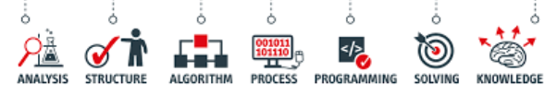
Introduction to Data Science

Slide 2
Objectives
Defining Data science
Fundamentals of Data science
The paths to Data science
The advice for new Data scientists

Slide 3
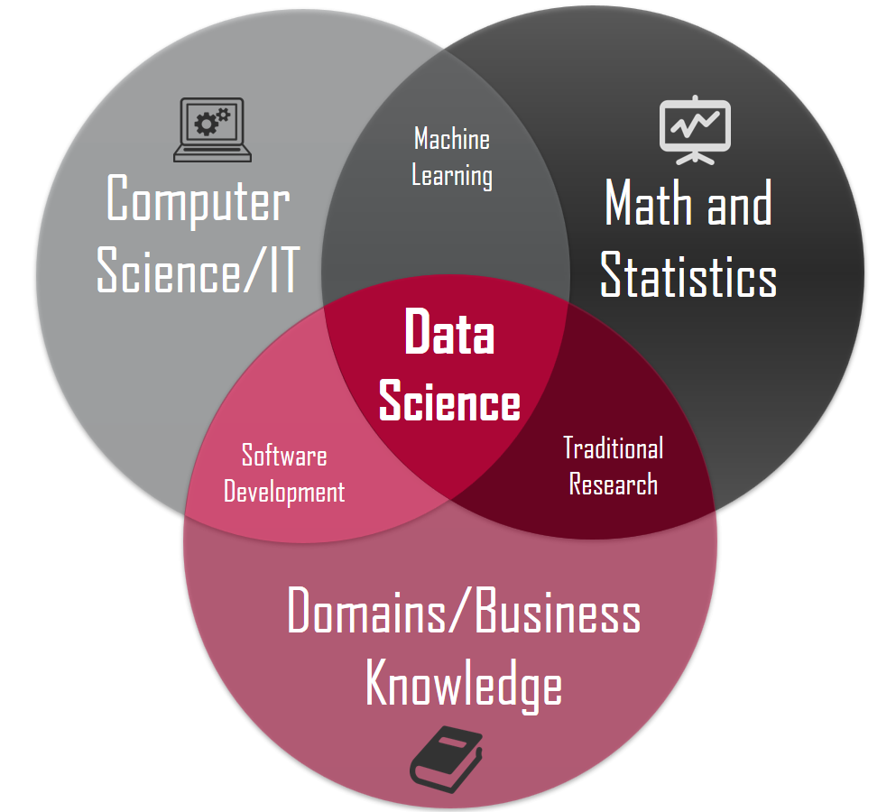
Defining Data Science
Data domain
Math and Statistics
Computer Science

Slide 4
Defining Data Science
The definition or the name came up in the 80s and 90s when some professors were looking into the statistics curriculum, and they thought it would be better to call it data science
Data Science is a process, not an event.
It is the process of using data to understand different things, to understand the world.
Data science is the process of uncovering the insights and trends that are hiding behind data. It's when you translate data into a story.
You can make strategic choices for a company or an institution.

Slide 5
Defining Data Science
Data science is a field about processes and systems to extract data from various forms of whether it is unstructured or structured form.
Data science is the study of data.
What is Data Science? → one's attempt to work with data, to find answers to questions that they are exploring.
If you have data, and you have curiosity, and you're working with data, and you're manipulating it, you're exploring it, the very exercise of going through analyzing data, trying to get some answers from it is data science.

Slide 6
Defining Data Science
Why is Data science for today?
  We have tons of data available
  We have algorithms
  We have open source and free
  Store datasets for a very low cost
The tools to work with data, the very availability of data, and the ability to store and analyze data, it's all cheap, it's all available, it's all ubiquitous, it's here.
There's never been a better time to be a data scientist.

Slide 7
Fundamentals of Data Science
Data analysis is a significant component of data science
Data analysis isn't new.
What is new is the vast quantity of data available from massively varied sources:
  log files
  email
  social media
  sales data
  patient information files
  sports performance data
  sensor data
  security cameras
  …

Slide 8
Fundamentals of Data Science
Computing power is needed to make a useful analysis and reveal new knowledge.
Data science can help organizations understand their environments, analyze existing issues, and reveal previously hidden opportunities.
Data scientists use data analysis to add to the knowledge of the organization by investigating data, exploring the best way to use it to provide value to the business.
Many organizations will use data science to focus on a specific problem, and so it's essential to clarify the question that the organization wants answered.

Slide 9
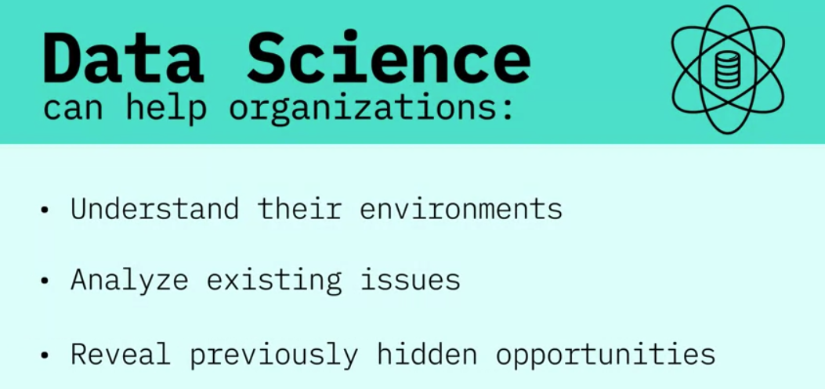
Fundamentals of Data Science

Slide 10
Fundamentals of Data Science
Data science steps in general:
  This first and most crucial step defines how the data science project progresses: good data scientists are curious people who ask questions to clarify the business need.
  The next questions are: "what data do we need to solve the problem, and where will that data come from?". Data scientists can analyze structured and unstructured data from many sources.
  Using multiple models to explore the data reveals patterns
  Data scientists can use powerful data visualization tools to help stakeholders understand the nature of the results, and the recommended action to take.
Data science is changing the way we work; it's changing the way we use data and it’s changing the way organizations understand the world.

Slide 11
The Many Paths to Data Science
Data science didn't exist until 2009, 2011.
Statistics is a classic form of data science. We studied math statistics, that's how we started.
Strategic consulting firms, they use data science to make decisions.
What we were doing was data science :
  Analyzing electronic point of sale data for retail manufacturers
  Transportation research
There are many paths to data science

Slide 12
The Many Paths to Data Science
Example the path to data science: transportation research.
  Building large models trying to forecast traffic on streets
  Trying to determine congestion and greenhouse gas emissions or tailpipe emissions.
  Working with very large data sets, looking at household samples of, say, 150,000 households from half a million trips
  Built even bigger data models that involved data and analytics.

Slide 13
Advice for New Data Scientists
An aspiring data scientist is to be curious, extremely argumentative, and judgmental.
Curiosity is absolute must. If you're not curious, you would not know what to do with the data.
Judgmental because if you do not have preconceived notions about things you wouldn't know where to begin with.
Argumentative because if you can argument and if you can plead a case, at least you can start somewhere and then you learn from data and then you modify your assumptions and hypotheses and your data would help you learn.

Slide 14
Advice for New Data Scientists
Don't be shy with the wrong point. You may say that I thought I believed this, but now with data I know this. So, this allows you a learning process.
The other thing that the data scientist should need is some comfort and flexibility with analytics platforms: some software, some computing platform.
The last thing that a data scientist need, and that is the ability to “tell a story”. That once you have your analytics, once you have your tabulations, now you should be able to tell a great story from it. Because if you don't tell a great story from it, your findings will remain hidden, remain buried, nobody would know.

Slide 15
Advice for New Data Scientists
Each field of health, education, and business,… has different characteristics and therefore requires different set of skills.
Figure out first what you're interested, and what is your competitive advantage.
Your competitive advantage is your understanding of some aspect of life where you exceed beyond others in understanding that.
You need to understand what platforms to learn, those tools would be specific to the industry that you're interested in.
The next thing would be to apply your skills to real problems, and then tell the rest of the world what you can do with it.

Slide 16
Summary
Defining Data science
Fundamentals of Data science
The paths to Data science
The advice for new Data scientists

Slide 17
Q & A

